Slide 1
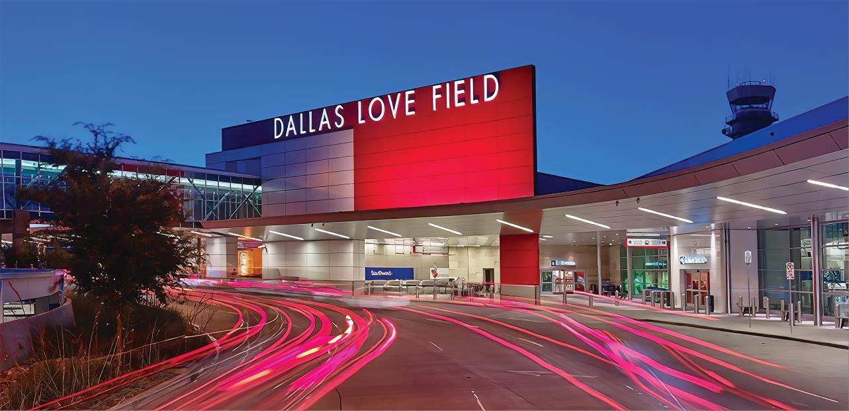
Love Field Environmental Advisory Committee Meeting
October 13th, 2022
Dallas Love Field
7555 Lemmon Ave

Slide 2

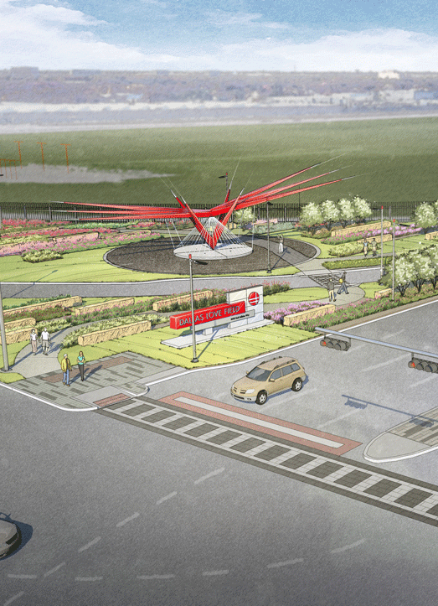
Agenda
Introductions
Voluntary Noise Program
  Noise Reports
  General Information
Noise Stakeholder Meetings Update
Open Discussion
Adjourn

Slide 3

Voluntary Noise
Program

Slide 4
Operation Statistics ( July – September 2022 )
Definitions
Air Carrier – A commercial carrier utilizing aircraft as its means of transport; an airline, as for passengers or freight.
General Aviation – All civil aviation operations other than scheduled air services and non‐scheduled air transport operations
for compensation or hire.
Other – Medical and Military flights
Source: Casper Airport Solutions Inc.

Slide 5
Runway Operations During Preferential Hours
Nighttime Preferential Runway (RWY 13R/31L) for all jet aircraft and any aircraft weighing over 12,500 pounds, between the hours of 9:00 p.m. and 6:00 a.m.
Deviation Report
  Categories considered: Pilot Request, Runway Unavailable, FAA Assigned & Weight
  No other credit categories will be considered such as weather or emergency status as this is difficult to track
  The analysis does not account for Helicopters as they do not utilize runways
  The following chart identify why aircraft use runway 13L/31R (Lemmon)

Slide 6
July 2022, 9:00 pm – 6:00 am
Source: Casper Airport Solutions Inc.

Slide 7
August 2022, 9:00 pm – 6:00 am
Source: Casper Airport Solutions Inc.

Slide 8
September 2022, 9:00 pm – 6:00 am
Source: Casper Airport Solutions Inc.

Slide 9
Deviation Report
August 2022
September 2022
Source: Casper Airport Solutions Inc.

Slide 10
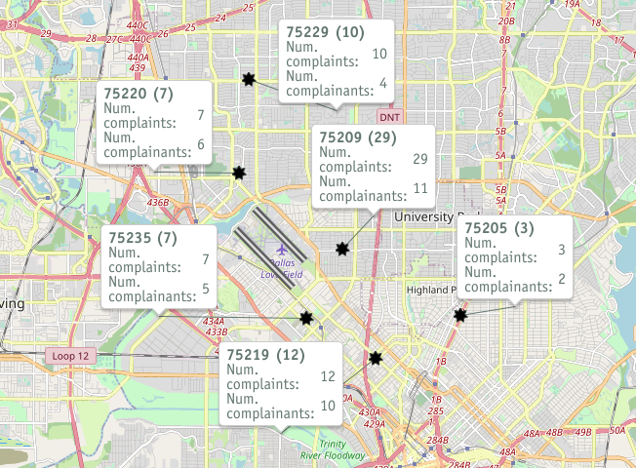
Noise Complaints ( July – September 2022 )
*Disclaimer: The map only displays zip codes
in the immediate Dallas Love Field area
Source: Casper Airport Solutions Inc.

Slide 11
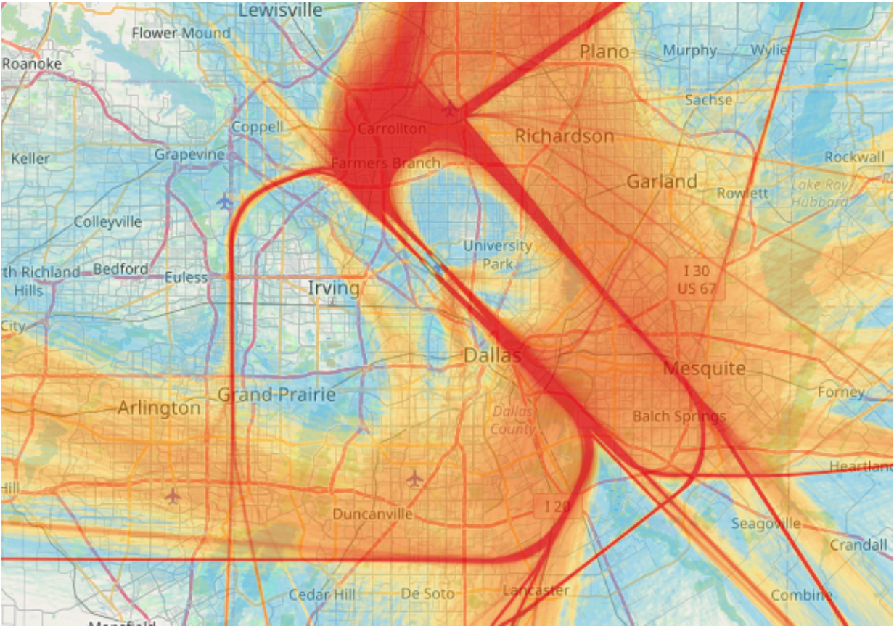

Radar Track
Density Map
( July – September 2022)
This is a graphical depiction for the frequency of aircrafts’ flight tracks over a defined area during the specified time period. This is an effective tool to illustrate arrival and departure routes.
Source: Casper Airport Solutions Inc.
Notes:
The following map takes all the flight track data for the given time period and creates the radar density map
Dark red in the middle of the picture shows the highest density of flight tracks over the runways.
The colors gradually move out to blue as the least dense.

Slide 12
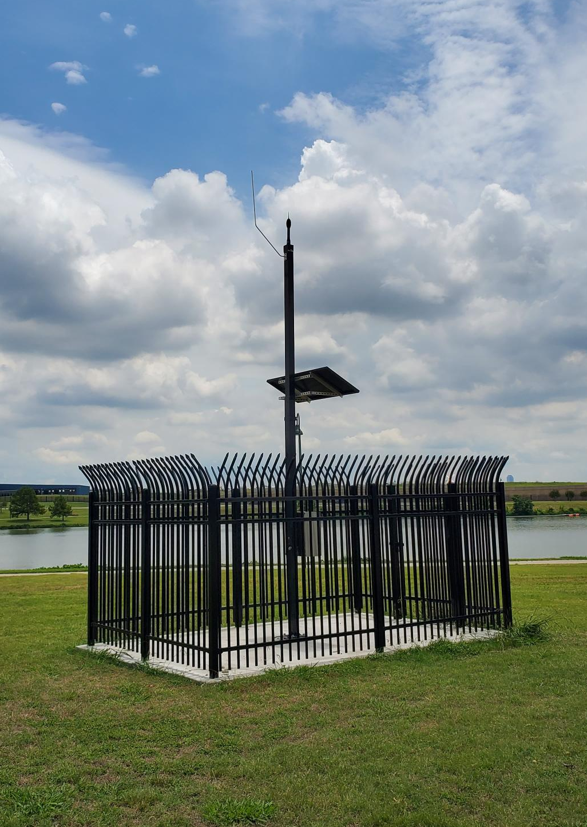
Dallas Love Field’s Voluntary Noise Program
To better respond to the concern of our neighbors, the City of Dallas’ Department of Aviation has developed a Voluntary Noise Program.
DOA serves as a liaison between the community and FAA while also disseminating noise information to stakeholders through outreach.
The Federal Aviation Administration manages all aspects of the National Airspace System in the United States.
FAA’s Air Traffic Control directs commercial air traffic to and from DAL Airport.
DAL’s Noise and Operations Monitoring System (NOMS) utilizes Casper Airport Solutions to monitor and understand aircraft.
Notes:
Casper airport solution is an advance NOM system that City of Dallas is utilizing
The system is comprised of 4 fixed noise monitors in the community.

Slide 13
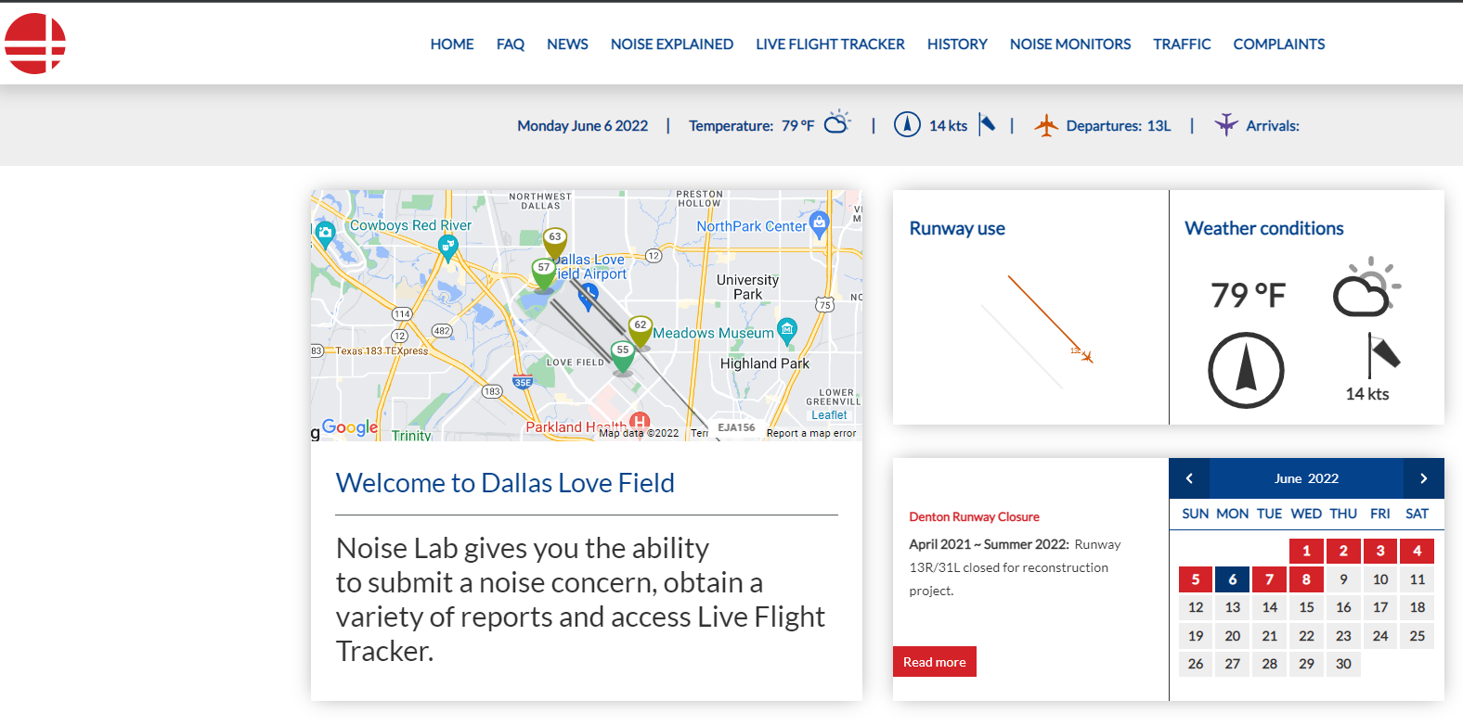
NoiseLab
Casper NoiseLab is an interactive public website that provides current information on aircraft noise, runway closures, outreach efforts and other useful information. It also displays statistical flights/noise information using both maps and charts.
https://dal.noiselab.casper.aero/

Slide 14
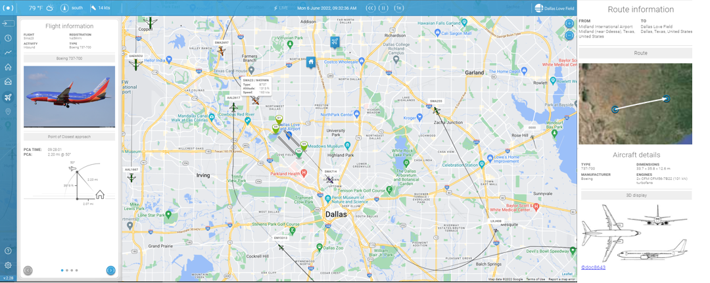
Flight Tracker
Dallas Love Field Airport has invested in an online tracking system for the movement of flights within the DFW Metroplex. Flight Tracker allows concerned individuals to research data on flights. The system simplifies the submission of noise complaints by offering an easy, online option for residents to register noise concerns.
https://flighttracker.casper.aero/dal/
Notes:
The public can view flights to and from Dallas Love Field Airport, Dallas Executive Airport as well as any transitional air traffic through the region
The public can link specific flights to their noise complaints, that in turn provide accurate information to the noise specialist.

Slide 15
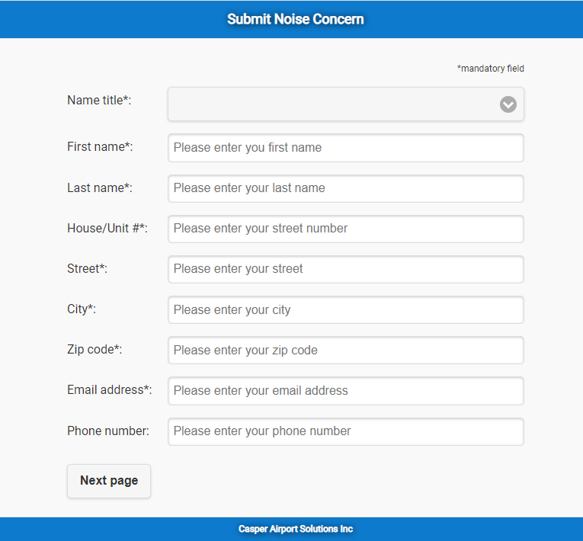
Submitting a Noise Complaint
All noise complaints are logged and reviewed daily by utilizing a Noise and Operations Monitoring System (NOMS) powered by Casper. DOA seeks to provide as much information as possible when investigating and responding to noise complaints.
Guidelines and Standards
Noise complaints will only be logged when they contain accurate and complete information, including the first and last name, physical address, date and time of the noise occurrence and means of contact (telephone number or email address) if feedback is requested.
It is recommended that noise complaints should be reported within one week of the occurrence.
The FAA’s Aviation Noise Ombudsman serves as a public liaison for issues about aircraft noise questions and complaints.
  FAA Noise Portal: https://noise.faa.gov/noise/pages/noise.html.
  Email : 9-asw-noise@faa.gov

Slide 16
Noise Stakeholder Meeting Update

Slide 17
Noise Stakeholders Meeting
The Department of Aviation is currently hosting a series of noise stakeholder meetings to review the Voluntary Noise Program (VNP) by discussing DAL’s current program and provide feasible noise measures to the FAA for their review and implementation.
The Goal is to provide information on aircraft noise, the opportunity to review the existing program, and suggest new/modified feasible noise mitigating measures.
Stakeholders consist of a third-party Facilitator, Consultants (HMMH), Federal Government (FAA), Department of Aviation Staff, Airline representatives, Airport tenants, School representatives, Neighborhood Associations, and Individual Residents.

Slide 18
Meeting Updates
Meeting 1 Agenda ( August 25th, 2022)
    Introduction to aircraft noise
    Aircraft noise regulation in the U.S.
    The existing Dallas Love Field (DAL) voluntary noise control program
    Historical DNL Contours
Meeting 2 Agenda (September 29th, 2022)
    Review existing Dallas Love Field (DAL) Voluntary Noise Program (VNP)
    Solicit stakeholder ideas and feedback on the current VNP
    Discuss possible modifications to the VNP in Working Groups
Meeting 3 – Upcoming (October 20th, 2022)
  Present Results of Program Review Analysis and Recommendation Elements
Meeting 4 – Upcoming (TBD)

Slide 19
Highlight Items from Second Meeting
Highlighted Items
1 | To ensure open communication, all questions, concerns, and suggestions can be sent to AVINoise@dallas.gov. The Department of Aviation will continue to accept any recommendations from participants even after the meetings.
2 | Department of Aviation will find more information regarding use of WhisperTrack to disseminate Voluntary Noise Program to pilots
3 | More information to be provided on why the Trinity Departure is not converted into a RNAV procedure and if it is possible to implement it for southbound departures on both runways during nighttime.
4 | Department of Aviation should share any questions and suggestions received to all participants in the Noise Stakeholder Meeting.
5 | Southwest Airline to check on scheduled flights times. It is reported that there were 6 arrivals scheduled after 11pm.
6 | External document was shared by stakeholders as an overview for the Department of Aviation to review. This document will be shared with all Participants

Slide 20
OPEN DISCUSSION and
QUESTIONS

Slide 21
Adjourn
Next LFEAC Meeting
on
January 12, 2023, at 6 p.m.
For noise concerns visit
https://dal.noiselab.casper.aero/
For noise inquires email
AVINoise@dallascityhall.com

